Slide 1
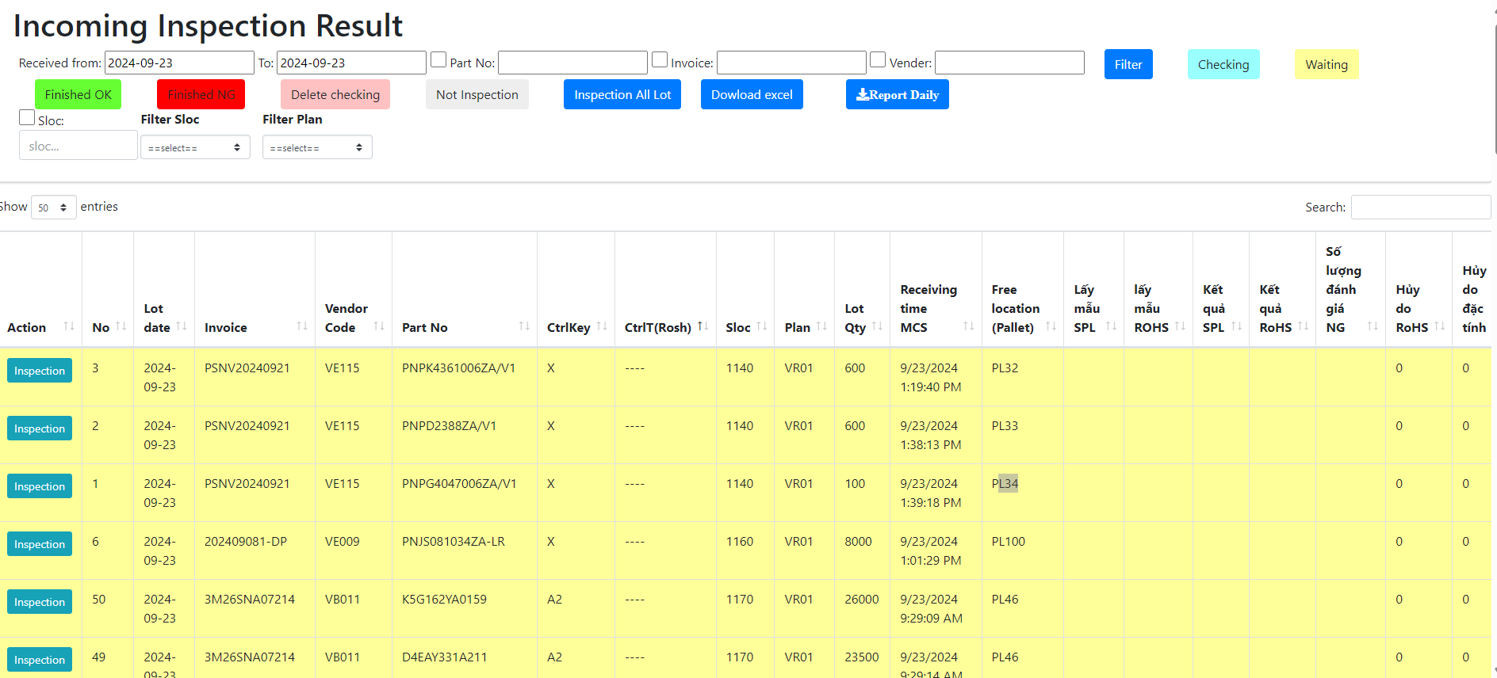



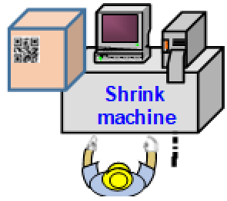
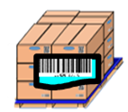
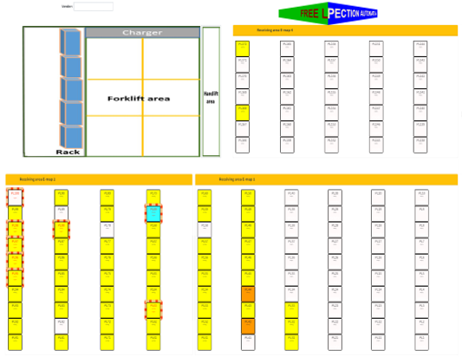


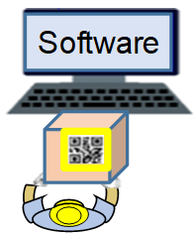
Link weight check system concept
1/5
Production
OQC visualize system
Shipment
PEM system
Record 4M change
Process quality issue
Purpose
Indicate process 4M/ Quality each Lot
Visualize OQC checking status
Indicate shipment permission
Trace back for Market feedback
VMS system
Visualize status of model following shipment plan daily
Link final confirmation to WMS/PDA
ADD
ADD
ADD
Weight check system
Production result
Link with ID pallet system
Shipment request (Priority)
Advantage
Remove manual Job FA/OQC/SCM
Eliminate human risk & follow up quality /4M issue to evaluate LOT
Visualize shipment permission timely
ADD
Visualize OQC inspection result
PEM
System
Link
Weight check
System
Link
OQC system
Link
VMS
System
ID pallet
Shipment
<Details in next page>
QC : △2pax / Save: 1,000H/Year
E-Map control
Auto system replace manual Job and visualize quality /4M information to evaluate Lot for shipment

Slide 2
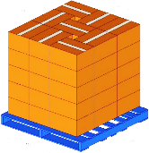
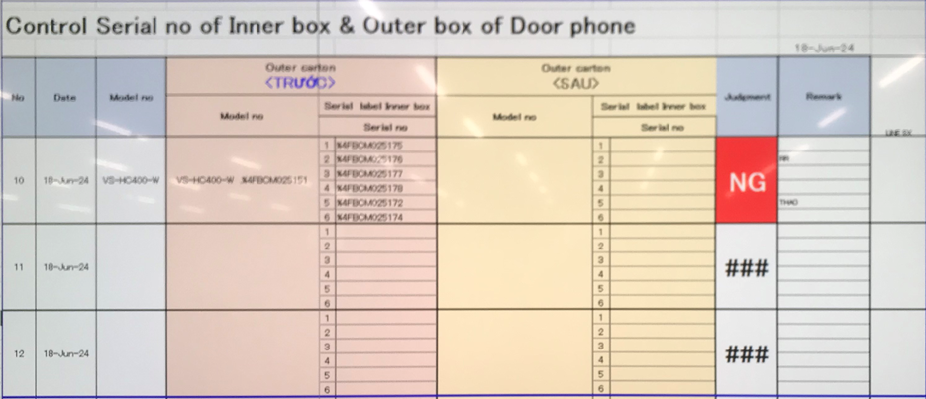
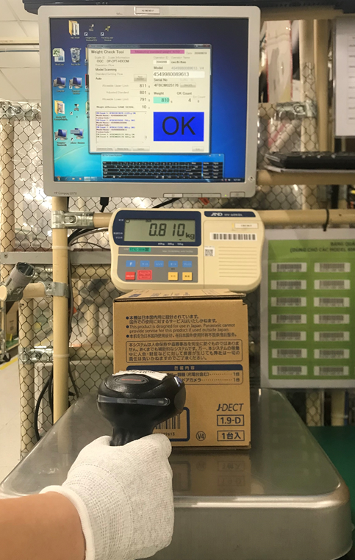
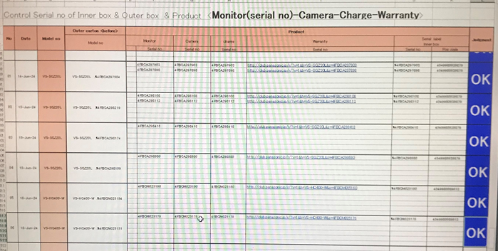
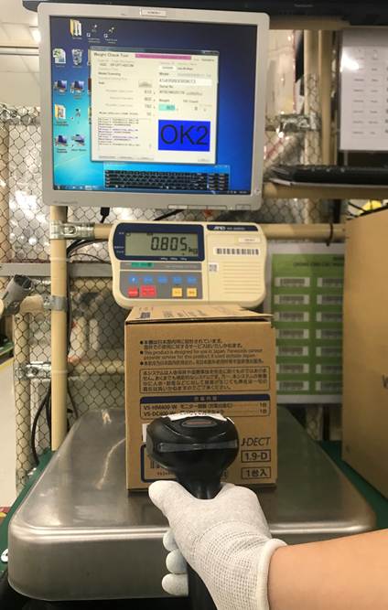
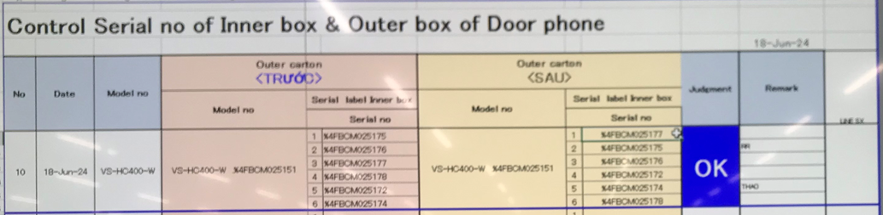
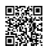

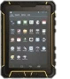
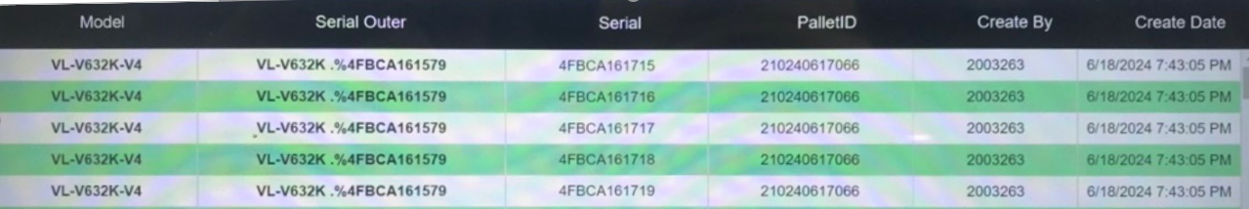
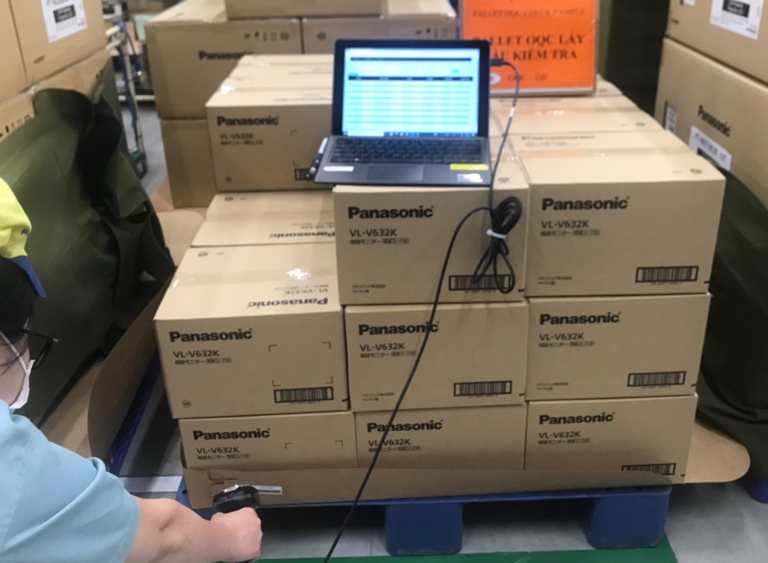
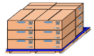
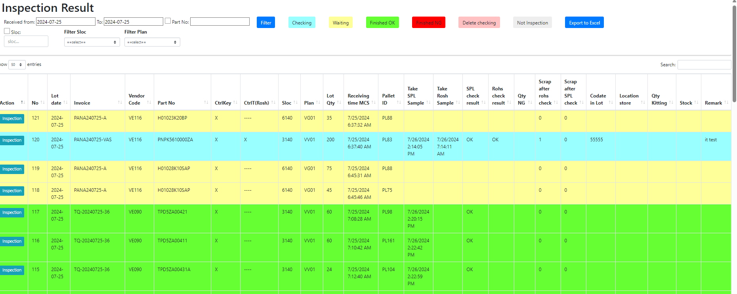
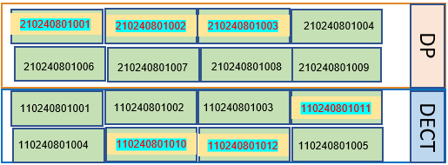
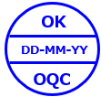
Link weight check system concept
2/5
Current situation OQC
Pick up sample
Reading barcode Inner/Outer excel file
Weight check 1st
OQC
inspection
Reading BC
Product/Inner excel file
Weight check 2nd
Reading barcode
Inner/Outer excel file
Return sample
No Link
No Link
3
No Link
Reliability
No Link
5
No Link
6
No Link
7
No Link
8
1
2
4
Production Line
Confirm S/N Outer & all inner boxes
Accessory control
Numbering control & Separate area
Product/Warranty/Manual & Inner box
Accessory control
Confirm S/N Outer & all inner boxes
Warehouse FA
Improvement
Software
Software
Software
1
2
3
4
5
6
7
8
Auto link weight FA
Auto link weight FA
Database server OQC
<Judgment Lot>
Before
E – chop replace physical stamp
After
Visualize FA-SCM W/H
Manual find pallet
<Physical stamp>

Slide 3
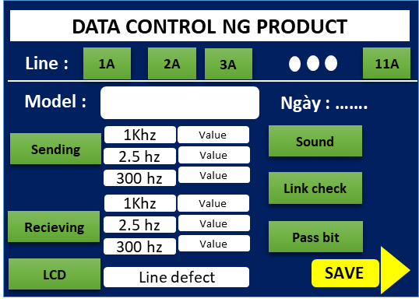
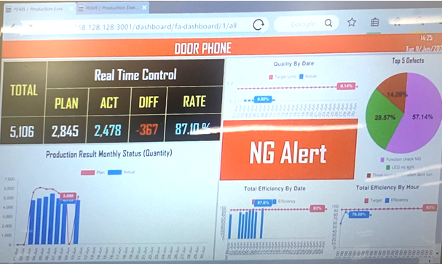

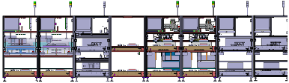


Defect system Process & OQC
3/5
Review current Quality Issue in PEMS system
No Link
Problem point:
System visualize quality situation on process only, no link with OQC system
PEM
System
OQC system
Quality issue
Improvement for Quality function in PEMS system: Link PEMS system with OQC system
OUT :
Indicate defect issue:
+ Focused defect to alarm
+ Happen on over 3 products
+ Repeat happen
PURPOSE :
Decide sampling Q’ty
Focus defect to take more action
Judgment for Lot
Trace back for Market issue
<FA line >
Link
OQC system
PEMS Server
<Quality Issue>
Alarm all Quality issues
Purpose: Follow Quality issue / Judgment Quality of Lot / Trace back Market claim

Slide 4


Link weight check system
Procurement activity
4/5
Equipment list require
Section | Name Equipment | Image | Function | Quantity
OQC | Tablet windows (Connect with barcode reader) |  | 1.1, Pick up sample 1.2, Return Sample 1.3, Find quickly Pallet ID and Model at FA & SCM area 1.4, Visualize OQC inspection with FA, SCM | 3
FA | Mobile device |  | 2.1, Fix in & fix out location 2.2, Check the status of the OQC inspection | 3

Slide 5
Link weight check system
5/5
Project Schedule
Plan
Actual
Go-live
Group Function | Department | Aug.24 | Sep.24 | Oct.24 | Nov.24 | Dec.24 | Jan.25 | Feb.25 | Mar.25
Meeting, discuss, analyze | SCM/QC/FA/IT
Upload plan, Pick-up sample | SCM/QC/FA/IT
Confirm Outer carton and inner box | QC/IT
Modify weight check OQC | QC/IT
OQC inspection & judgment all lots | SCM/QC/FA/IT
Visualize inspection result OQC | -SCM/QC/FA/IT
Report daily OQC | QC/IT

